Slide 1



Dog Breed Identification
PRESENTED BY: COBRA BYTES

Slide 2
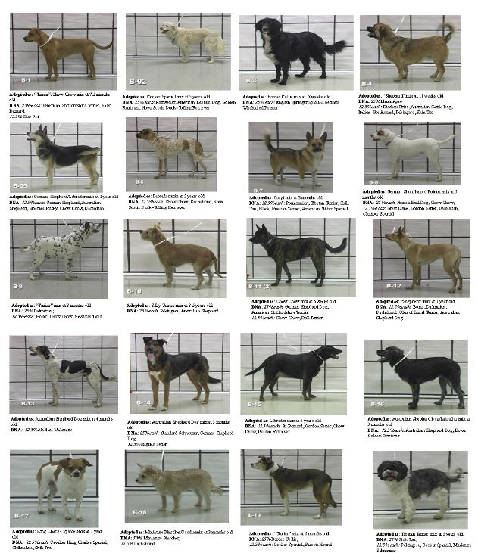
Introduction
THIS PRESENTATION WILL EXPLORE THE USE OF CONVOLUTIONAL NEURAL NETWORKS AND IMAGE PROCESSING TO ACCURATELY IDENTIFY DOG BREEDS

Slide 3

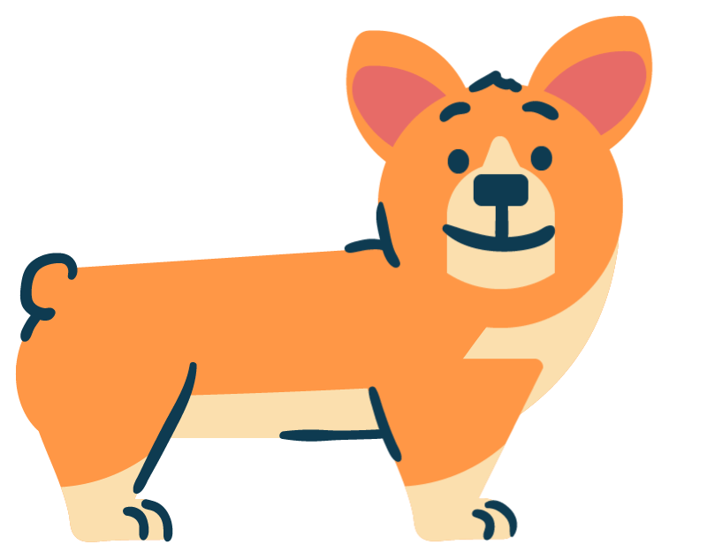
Background and Comparison

Slide 4
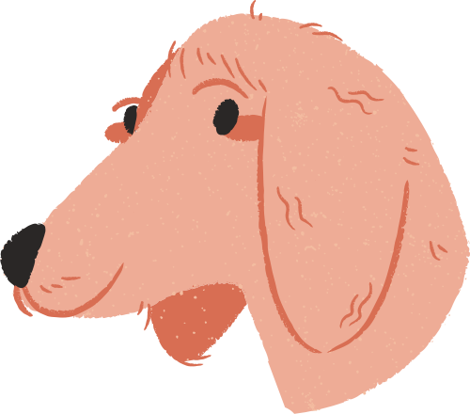

Background
This project hopes to identify dog breeds from images. This is a fine-grained classification problem: all breeds of Canis lupus familiaris share similar body features and overall structure, so differentiating between breeds is a difficult problem. Furthermore, there is low inter-breed and high intra-breed variation; in other words, there are relatively few differences between breeds and relatively large differences within breeds, differing in size, shape, and color.

Slide 5

Comparison
In our work, we attempt to use a convolutional neural network to assist with keypoint detection in dogs, namely identifying eyes, nose, and ears. CNNs have seen success in identifying facial keypoints in humans, and we hope to apply this technique to dogs as well. By doing so, we eliminate dog face detection as a step in the process, and replace Liu et. also part localization process.

Slide 6

Keypoint Detection

Slide 7
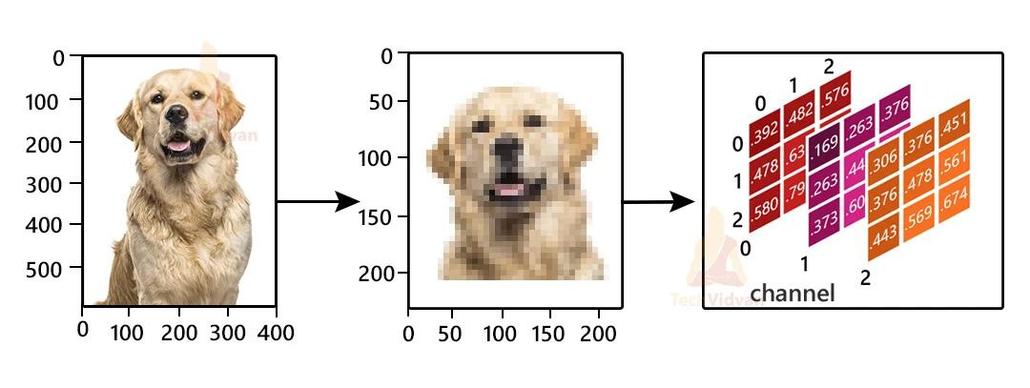

Keypoint Detection

Slide 8
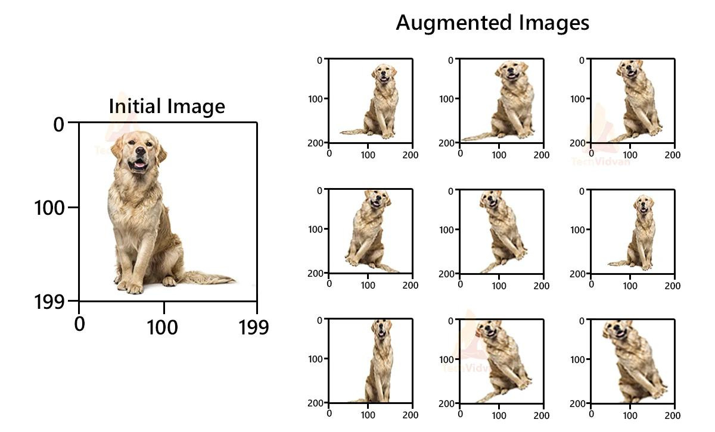

Keypoint Detection

Slide 9

Classification

Slide 10

Classification
We were also interested in comparing how well our different features did relative to one another. Comparing different feature sets across our best performing model (the SVM with linear kernel), we found that our RGB histogram actually added noise to the feature set, while the color centers histogram (centered on dog faces) added useful information, albeit only by a few percentage points of accuracy increase

Slide 11
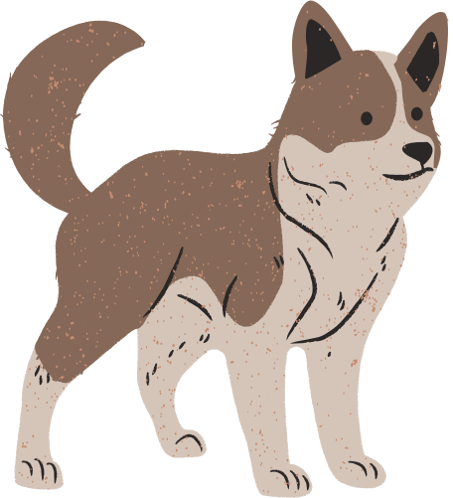
Conclusion
Dog Breed Classification Project which uses CNN's to classify real world dog images and predict their breed out of 8000 breeds/classes. If supplied an image of a dog face, the code will identify the resembling dog breed. Achieved an accuracy of 58% (with just one epoch!!!) and It takes the age & weight of the dog and tell the diet plan for it like Overweight, Ideal, underweight using this data it predict exercise over weight

Slide 12

Thank you

